Slide 1
PowerShell: How to Tame the Event Log Beast
Phil Bossman
@Schlauge
1 / 15

Slide 2


Slide 3


PowerShell: How to Tame the Event Log Beast
PowerShell Enthusiast
EUC Architect
Cloud
Research Triangle PowerShell User Group
* part-time hiker

Slide 4

PowerShell: How to Tame the Event Log Beast
Agenda
Get-WinEvent
XML?
WEF / WEC
Event Triggers

Slide 5
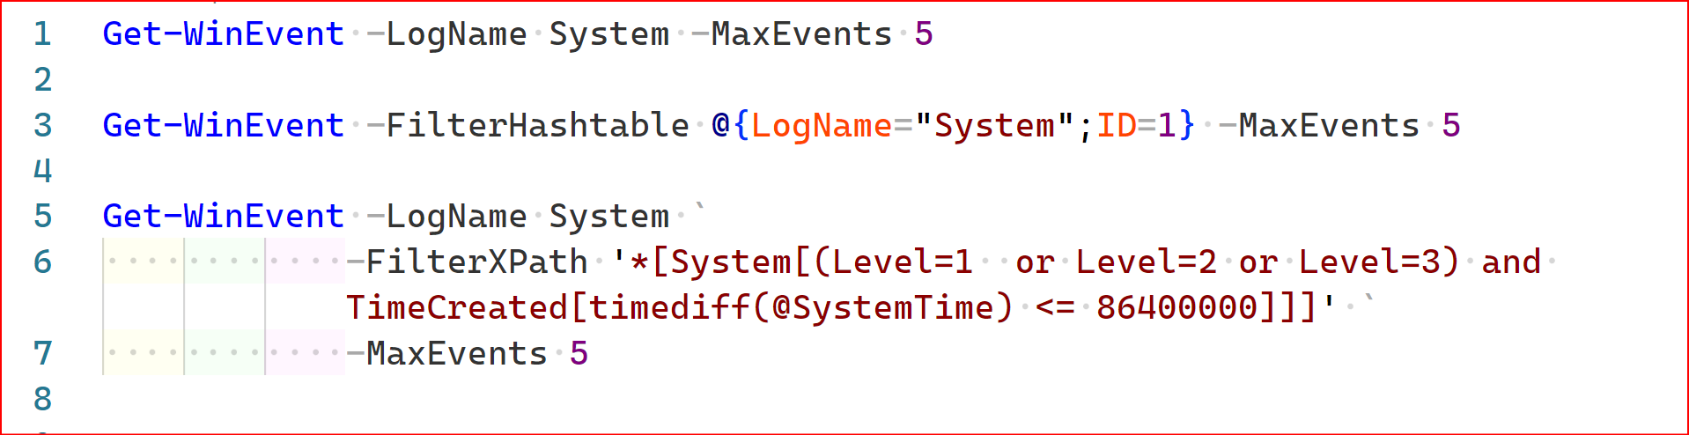
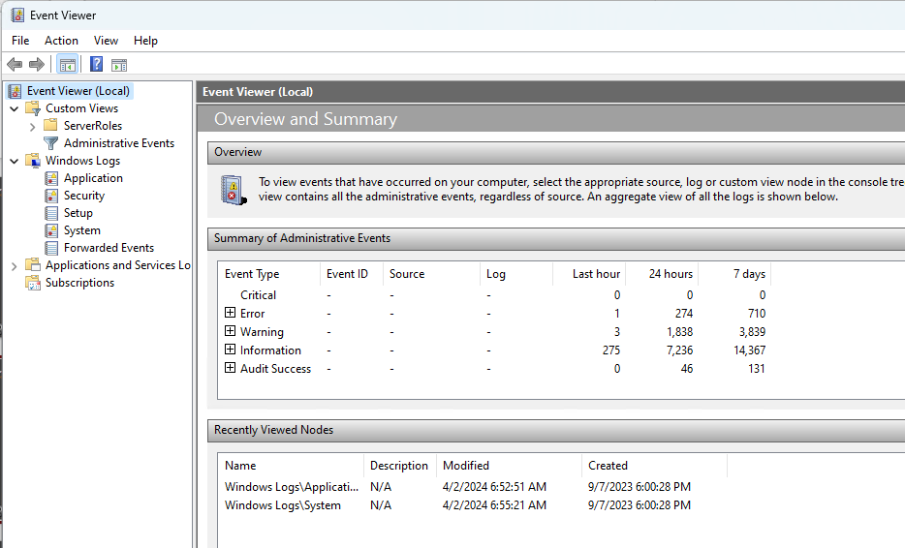
PowerShell: How to Tame the Event Log Beast
Get-WinEvent -LogName System
Windows Event Viewer

Slide 6
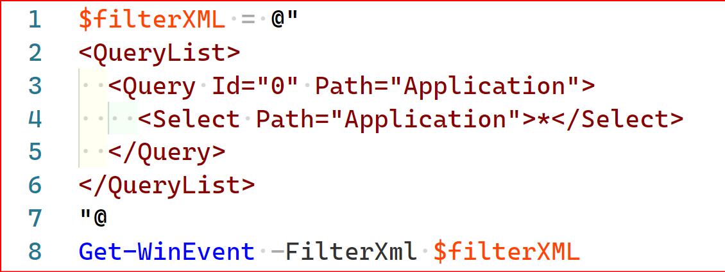
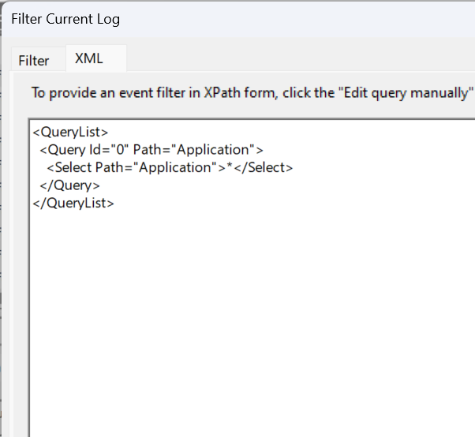
PowerShell: How to Tame the Event Log Beast
XML is your friend…

Slide 7
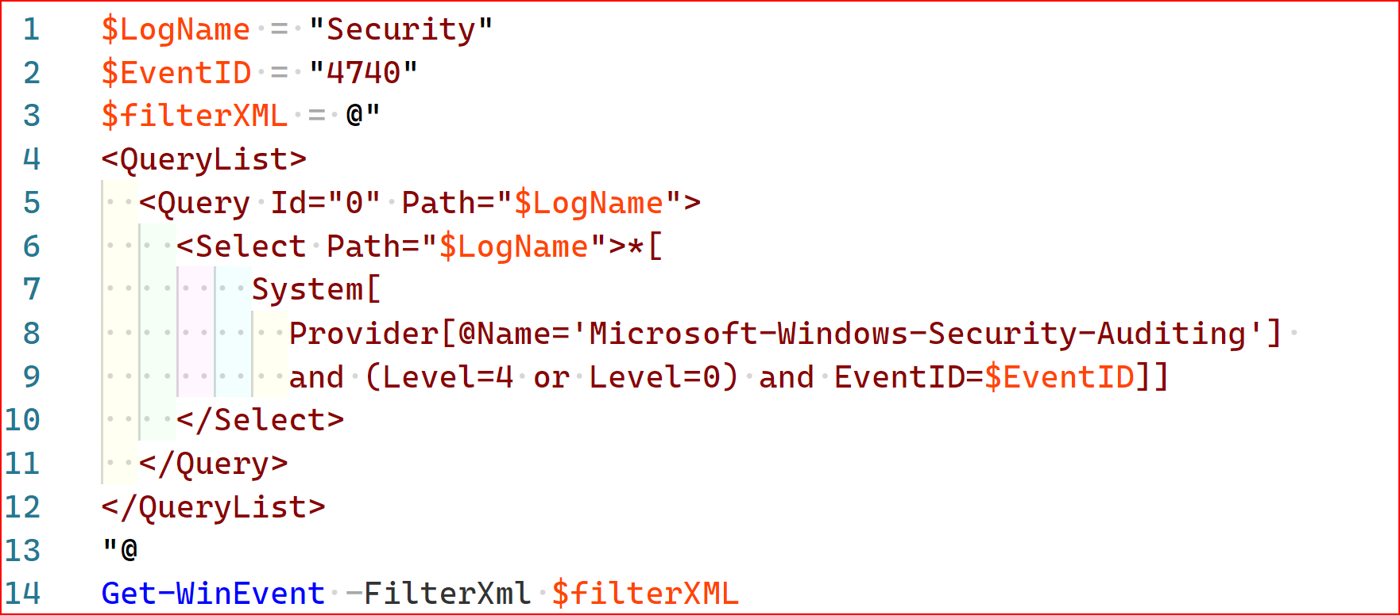
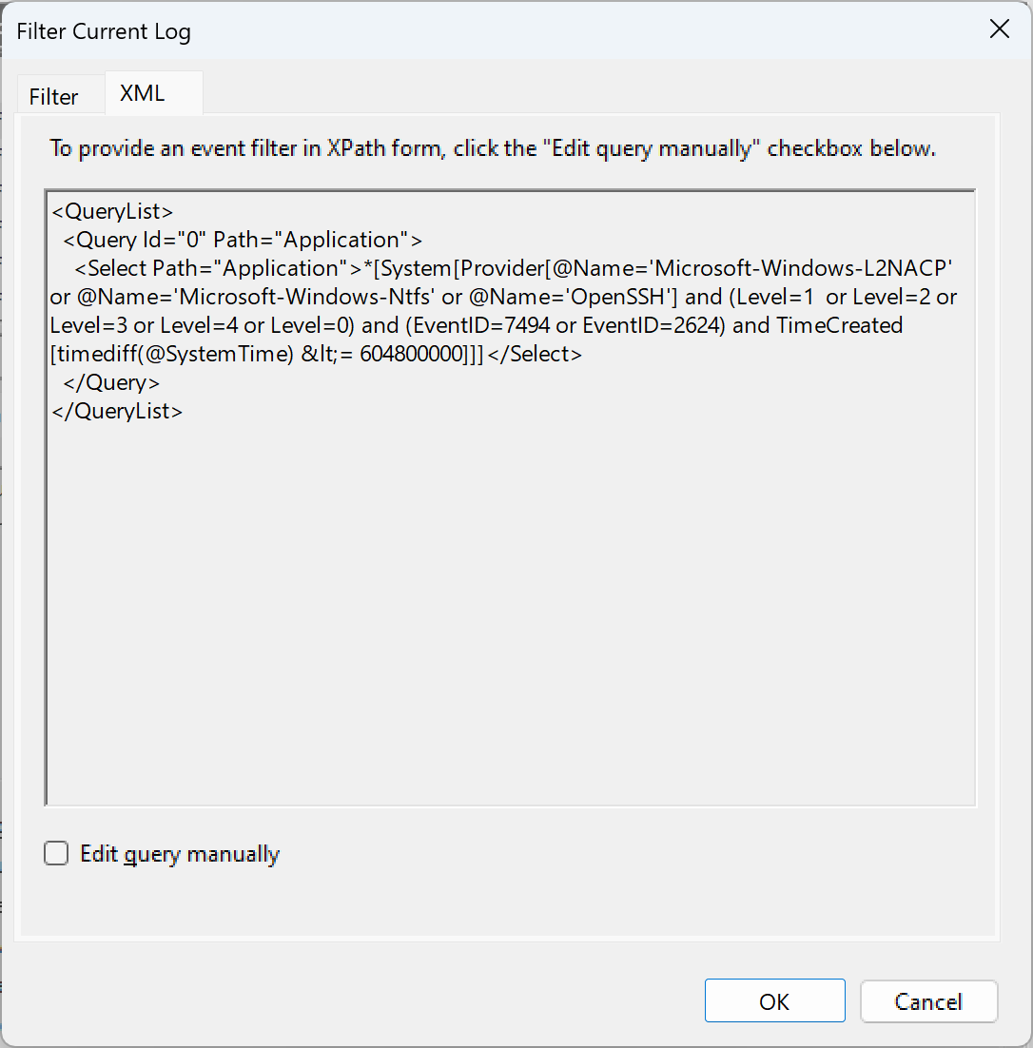
PowerShell: How to Tame the Event Log Beast
…and can be dynamic….

Slide 8
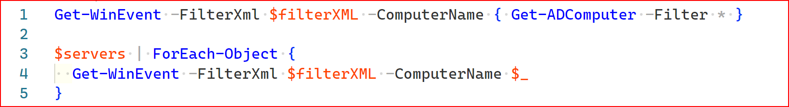
Getting events at scale

Slide 9
PowerShell: How to Tame the Event Log Beast
Getting events at scale

Slide 10
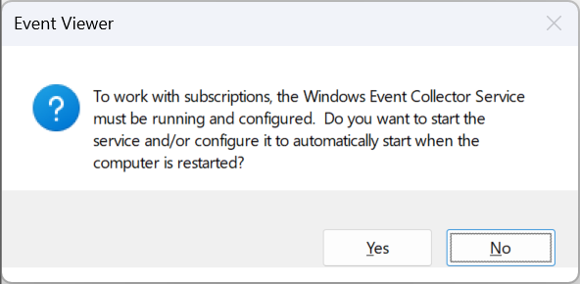
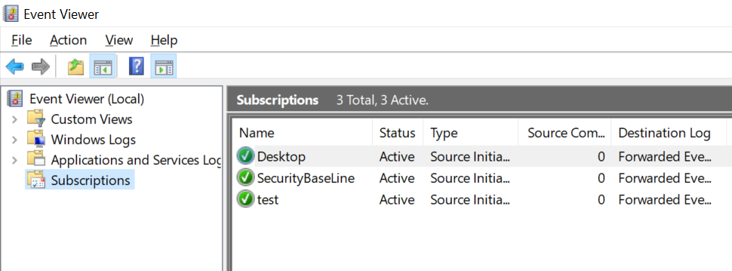
PowerShell: How to Tame the Event Log Beast
Windows Event Collectors

Slide 11
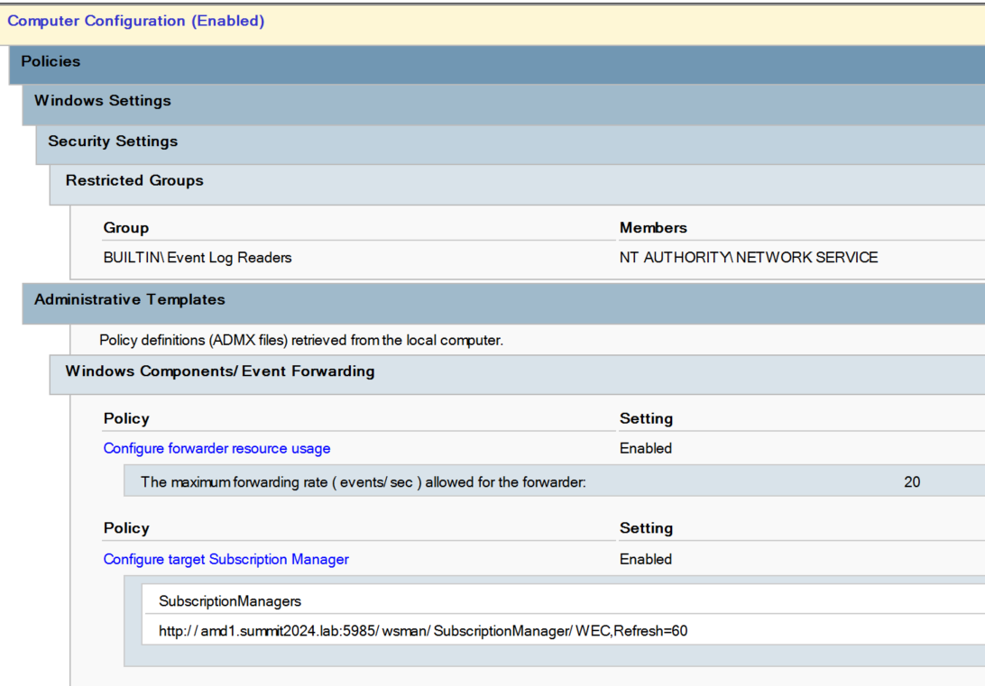
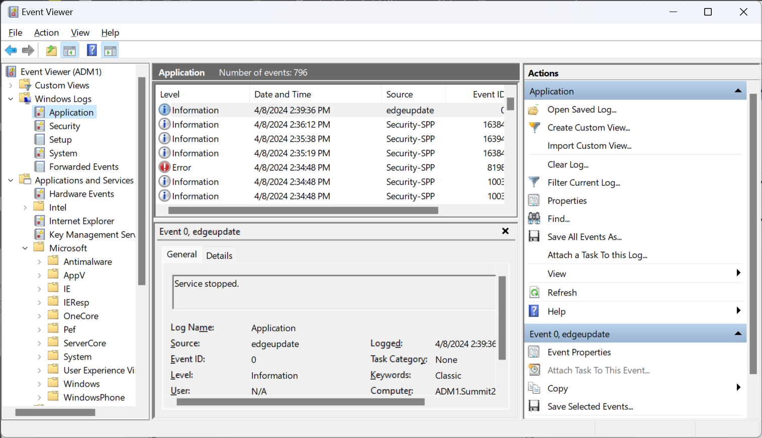
PowerShell: How to Tame the Event Log Beast
Windows Event Log Forwarding

Slide 12
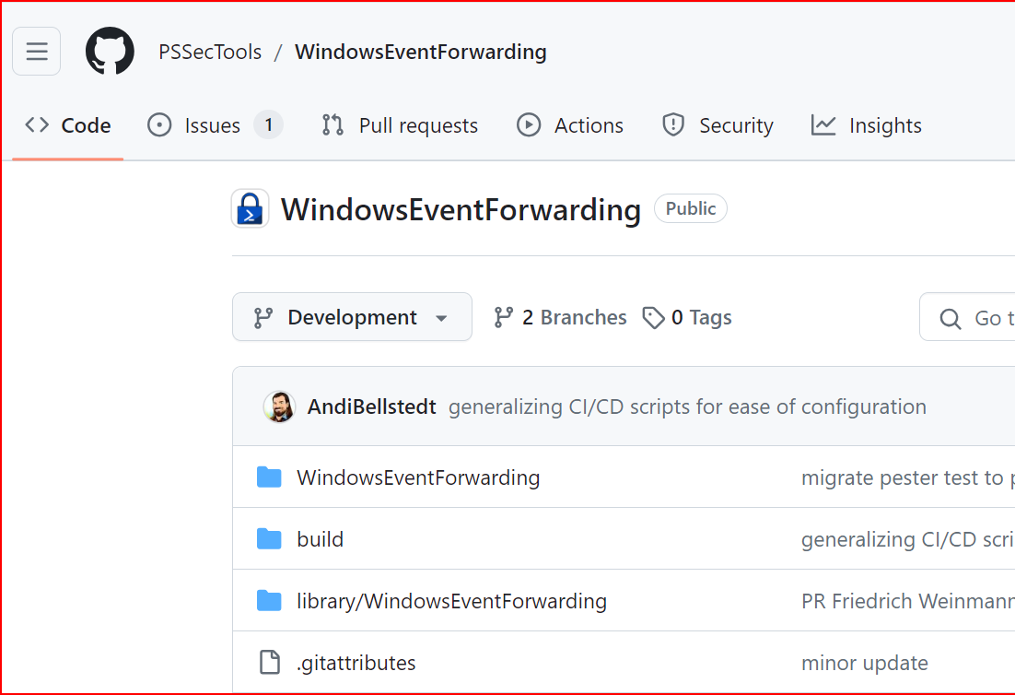
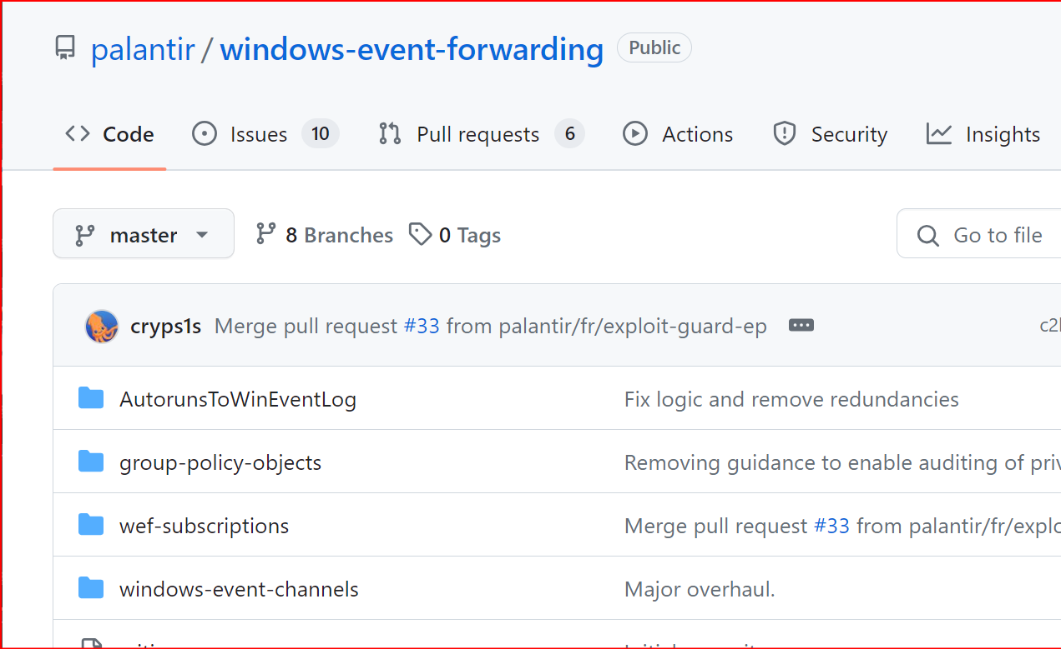
The community is AWESOME

Slide 13
Scheduled Tasks Trigger Demo
Notes:
Types of alerts to trigger events on
- Account Lock outs
- Application Crashes
- Domain admin logins to non-secured endpoints
- File Access

Slide 14
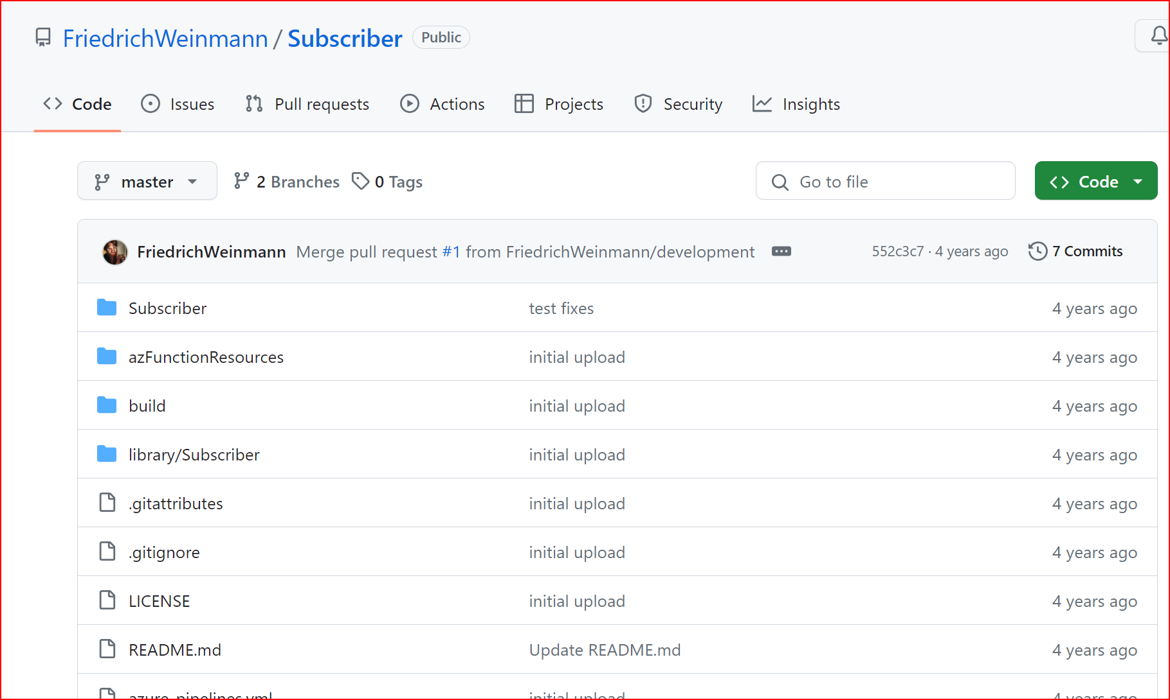
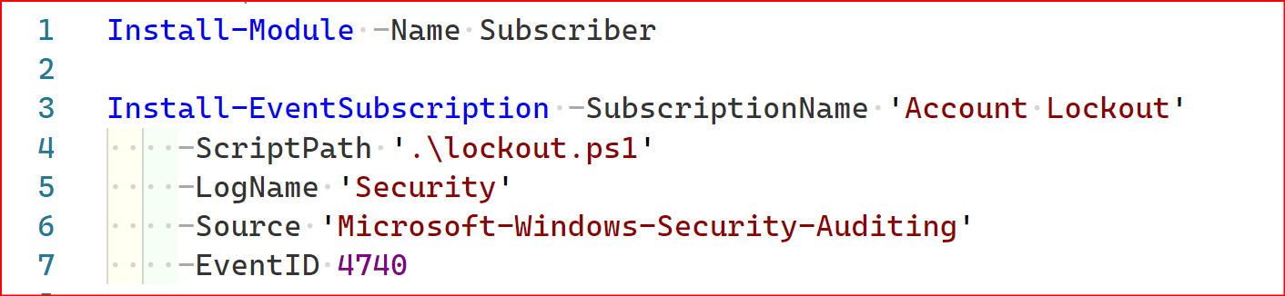
The community is SUPER AWESOME

Slide 15

THANK YOU
Please review this session

